Slide 1
第9章-3 激光的控制
——调Q与锁模

Slide 2
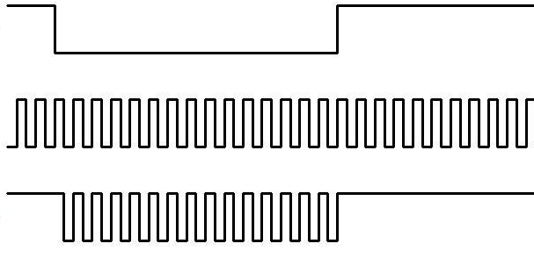
Continuous wave operation
For continuous wave operation, it is required for the population inversion of the gain medium to be continually replenished by a steady pump source.
Modulator

Slide 3
Pulsed operation
Q-switching, sometimes known as giant pulse formation
The technique allows the production of light pulses with extremely high (gigawatt) peak power, much higher than would be produced by the same laser if it were operating in a continuous wave (constant output) mode. Compared to modelocking, another technique for pulse generation with lasers, Q-switching leads to much lower pulse repetition rates, much higher pulse energies, and much longer pulse durations.

Slide 4
Q-switching is achieved by putting some type of variable attenuator inside the laser's optical resonator. When the attenuator is functioning, light which leaves the gain medium does not return, and lasing cannot begin. This attenuation inside the cavity corresponds to a decrease in the Q factor or quality factor of the optical resonator. A high Q factor corresponds to low resonator losses per roundtrip, and vice versa. The variable attenuator is commonly called a "Q-switch", when used for this purpose.

Slide 5
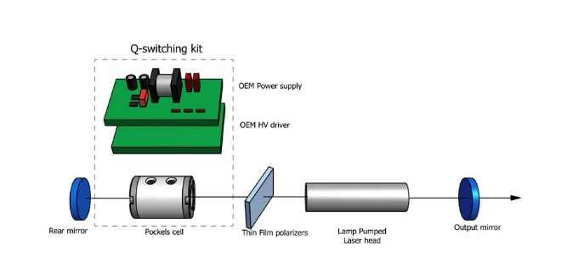

Slide 6
Initially the laser medium is pumped while the Q-switch is set to prevent feedback of light into the gain medium (producing an optical resonator with low Q). This produces a population inversion, but laser operation cannot yet occur since there is no feedback from the resonator. Since the rate of stimulated emission is dependent on the amount of light entering the medium, the amount of energy stored in the gain medium increases as the medium is pumped. Due to losses from spontaneous emission and other processes, after a certain time the stored energy will reach some maximum level; the medium is said to be gain saturated.

Slide 7
At this point, the Q-switch device is quickly changed from low to high Q, allowing feedback and the process of optical amplification by stimulated emission to begin. Because of the large amount of energy already stored in the gain medium, the intensity of light in the laser resonator builds up very quickly; this also causes the energy stored in the medium to be depleted almost as quickly. The net result is a short pulse of light output from the laser, known as a giant pulse, which may have a very high peak intensity.

Slide 8
Active Q-switching
Q-switch is an externally controlled variable attenuator. This may be a mechanical device such as a shutter, chopper wheel, or spinning mirror/prism placed inside the cavity, or (more commonly) it may be some form of modulator such as an acousto-optic device, a magneto-optic effect device or an electro-optic device — a Pockels cell or Kerr cell.
The pulse repetition rate can therefore be externally controlled. Modulators generally allow a faster transition from low to high Q, and provide better control.

Slide 9
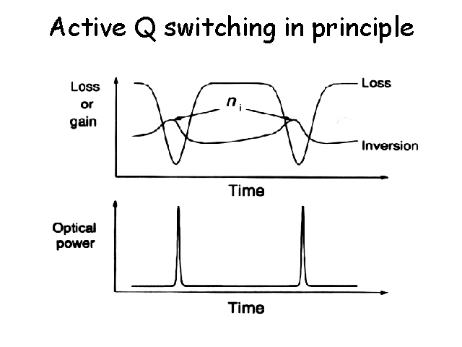

Slide 10
Passive Q-switching
Q-switch is a saturable absorber, a material whose transmission increases when the intensity of light exceeds some threshold.
Initially, the loss of the absorber is high, but still low enough to permit some lasing once a large amount of energy is stored in the gain medium. As the laser power increases, it saturates the absorber, i.e., rapidly reduces the resonator loss, so that the power can increase even faster. Ideally, this brings the absorber into a state with low losses to allow efficient extraction of the stored energy by the laser pulse.

Slide 11
Passive Q-switching
After the pulse, the absorber recovers to its high-loss state before the gain recovers, so that the next pulse is delayed until the energy in the gain medium is fully replenished. The pulse repetition rate can only indirectly be controlled, e.g. by varying the laser's pump power and the amount of saturable absorber in the cavity.

Slide 12
performance
A typical Q-switched laser (e.g. a Nd:YAG laser) with a resonator length of e.g. 10 cm can produce light pulses of several tens of nanoseconds duration. Even when the average power is well below 1 W, the peak power can be many kilowatts. Large-scale laser systems can produce Q-switched pulses with energies of many joules and peak powers in the gigawatt region. On the other hand, passively Q-switched microchip lasers (with very short resonators) have generated pulses with durations far below one nanosecond and pulse repetition rates from hundreds of hertz to several megahertz (MHz)

Slide 13
Mode-locking
a technique in optics by which a laser can be made to produce pulses of light of extremely short duration, on the order of picoseconds (10⁻¹² s) or femtoseconds (10⁻¹⁵ s).
The basis of the technique is to induce a fixed-phase relationship between the longitudinal modes of the laser's resonant cavity. The laser is then said to be 'phase-locked' or 'mode-locked'. Interference between these modes causes the laser light to be produced as a train of pulses.

Slide 14
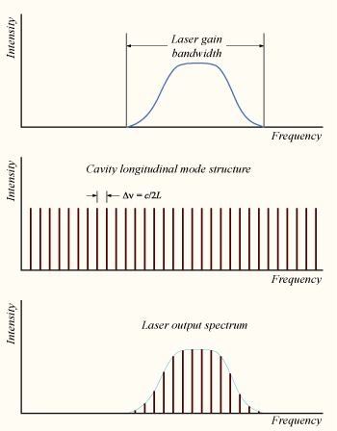

Slide 15
In a simple laser, each of these modes oscillates independently
If instead of oscillating independently, each mode operates with a fixed phase between it and the other modes, the laser output behaves quite differently. Instead of a random or constant output intensity, the modes of the laser will periodically all constructively interfere with one another, producing an intense burst or pulse of light. Such a laser is said to be 'mode-locked' or 'phase-locked'. These pulses occur separated in time by τ = 2L/c, where τ is the time taken for the light to make exactly one round trip of the laser cavity.

Slide 16
The duration of each pulse of light is determined by the number of modes which are oscillating in phase
If there are N modes locked with a frequency separation Δν, the overall mode-locked bandwidth is NΔν, and the wider this bandwidth, the shorter the pulse duration from the laser.
for a laser producing pulses with a Gaussian temporal shape, the minimum possible pulse duration Δt is given by Δt=0.441/ NΔν
The value 0.441 is known as the 'time-bandwidth product' of the pulse, and varies depending on the pulse shape.

Slide 17
For the HeNe laser with a 1.5-GHz spectral width, the shortest Gaussian pulse consistent with this spectral width would be around 300 picoseconds; for the 128-THz bandwidth Ti:sapphire laser, this spectral width would be only 3.4 femtoseconds.

Slide 18
Active mode-locking
The most common active mode-locking technique places a standing wave electro-optic modulator into the laser cavity. When driven with an electrical signal, this produces a sinusoidal amplitude modulation of the light in the cavity. Considering this in the frequency domain, if a mode has optical frequency ν, and is amplitude-modulated at a frequency f, the resulting signal has sidebands at optical frequencies ν − f and ν + f. If the modulator is driven at the same frequency as the cavity-mode spacing Δν, then these sidebands correspond to the two cavity modes adjacent to the original mode.

Slide 19
Since the sidebands are driven in-phase, the central mode and the adjacent modes will be phase-locked together. Further operation of the modulator on the sidebands produces phase-locking of the ν − 2f and ν + 2f modes, and so on until all modes in the gain bandwidth are locked.

Slide 20
This process can also be considered in the time domain. The amplitude modulator acts as a weak 'shutter' to the light bouncing between the mirrors of the cavity, attenuating the light when it is "closed", and letting it through when it is "open". If the modulation rate f is synchronised to the cavity round-trip time τ, then a single pulse of light will bounce back and forth in the cavity.

Slide 21
The actual strength of the modulation does not have to be large; a modulator that attenuates 1% of the light when "closed" will mode-lock a laser, since the same part of the light is repeatedly attenuated as it traverses the cavity.

Slide 22
Passive mode-locking
Passive mode-locking techniques are those that do not require a signal external to the laser (such as the driving signal of a modulator) to produce pulses. Rather, they use the light in the cavity to cause a change in some intracavity element, which will then itself produce a change in the intracavity light. A commonly used device to achieve this is a saturable absorber.

Slide 23
A saturable absorber is an optical device that exhibits an intensity-dependent transmission. What this means is that the device behaves differently depending on the intensity of the light passing through it. For passive mode-locking, ideally a saturable absorber will selectively absorb low-intensity light, and transmit light which is of sufficiently high intensity.

Slide 24
If the pulse generation process begins automatically after switching on the laser, this is called self-starting mode locking. Usually, the laser first starts operation in a more or less continuous way, but with significant fluctuations of the laser power (→ laser noise). In each resonator round trip, the saturable absorber will then favor the light which has somewhat higher intensities, because this light can saturate the absorption slightly more than light with lower intensities. After many round trips, a single pulse will remain (principle of “the winner takes all”).

